Slide 1
Understanding Partnership in Scientific Collaborations from the Paper-level Perspective A Preliminary Study
By Chao Lu, Mengting Li, Chenyu Zhou
From Hohai University

Slide 2

Background
Golden Trio

Slide 3

Outline
Introduction
Related Work
Data and Methods
Preliminary Findings
Conclusion

Slide 4
Introduction
Scientific collaboration is more and more common
Studies shew that scientific collaboration benefits scientific performance
Mechanism inside scientific collaborations is barely clear
Partnership as a form of close collaborative relationship in scientific team could be vital in scientific collaboration
To measure partnership in scientific collaboration through the lens of author contribution statements

Slide 5
Related Work
Scientific collaboration (Larivière et al., 2015)
Partnership as super tie investigated on co-authorship network (Petersen, 2015; Liu, et al., 2014)
Author contribution studies on scientific collaboration(Lu et al., 2022)

Slide 6
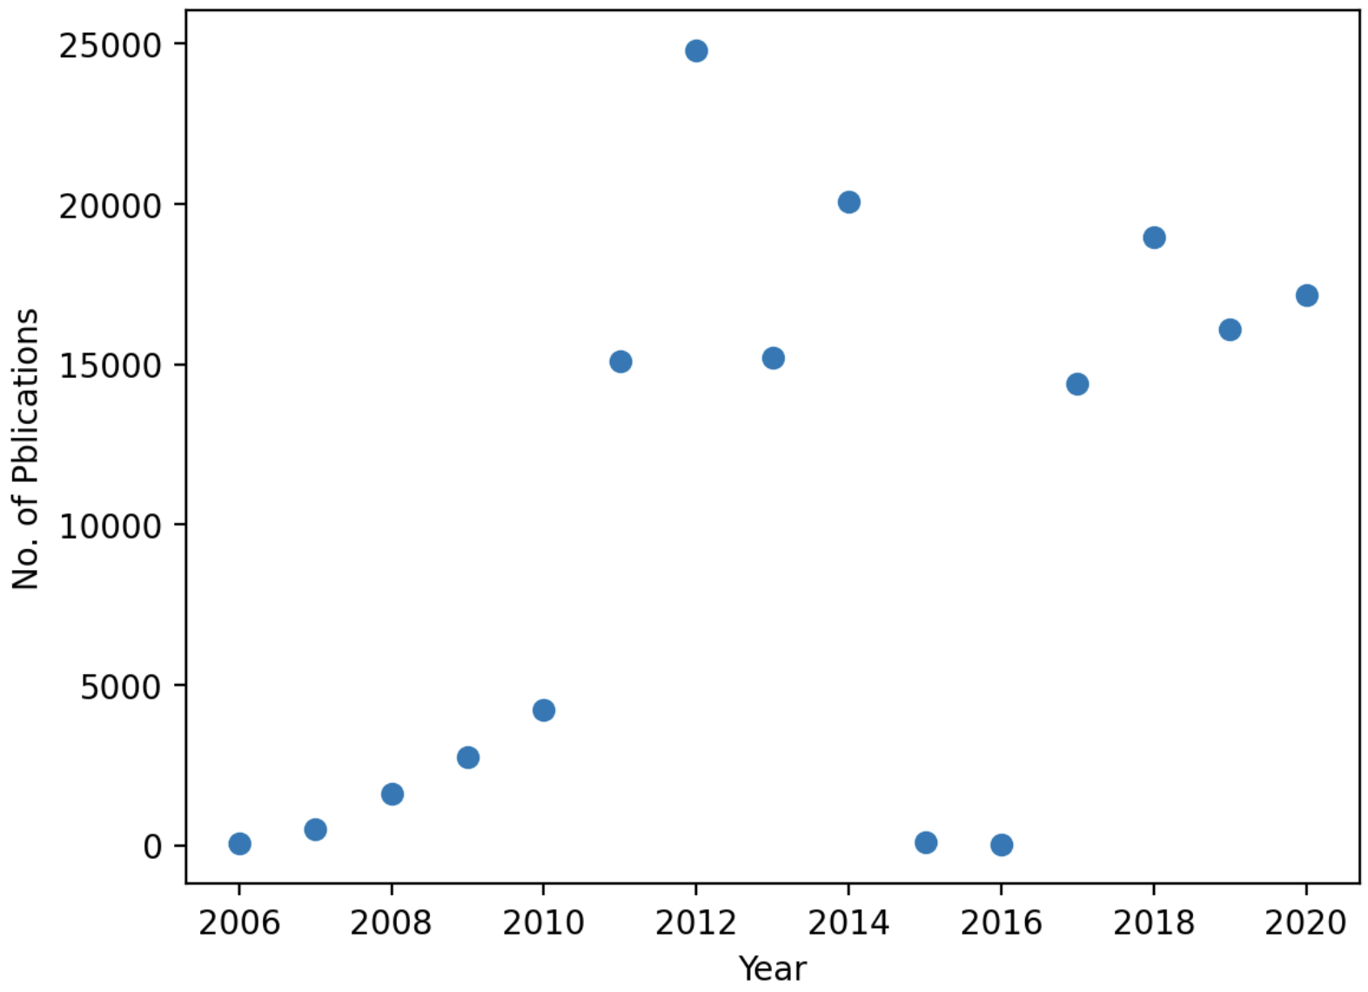
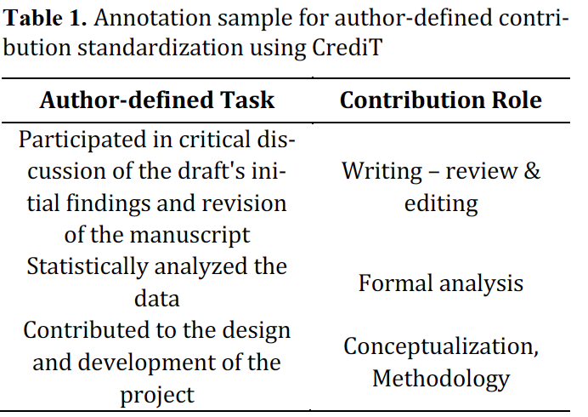
Data
126,894 articles in the Biology domain from PLoS (Public Library of Science) from 2006 to 2020
5,154 more author- task pairs via parsing author contribution statements embedded (Lu et al., 2020)
Cleaning and Annotation

Slide 7
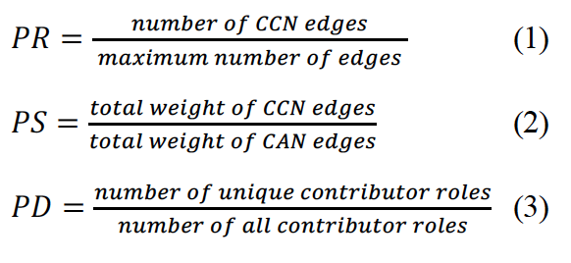
Methods
Paper-level co-contributorship network （CCN） （Lu et al., 2020）
Paper-level co-authorship network （CAN）
Measurements
Partnership Ratio（PR）
Partnership Strength（PS）
Partnership Diversity （PD）

Slide 8
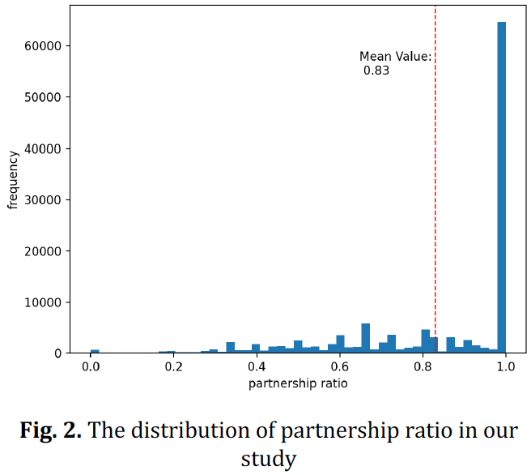
Preliminary Findings
PR
The plot suggests that generally in each team exists some level of partnership
Not all research teams contain partnership （Given so many 1 values）

Slide 9
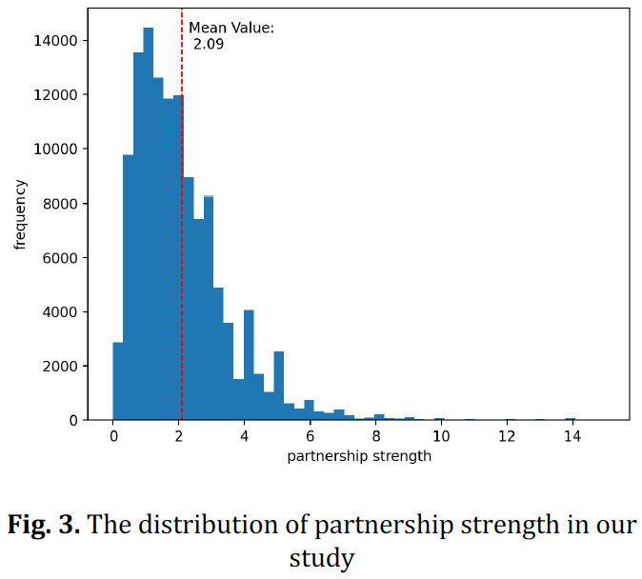
Preliminary Findings
PS
Given the limited existence of partnership in scientific collaboration，the partnership strength is relatively strong than that in CAN forms

Slide 10
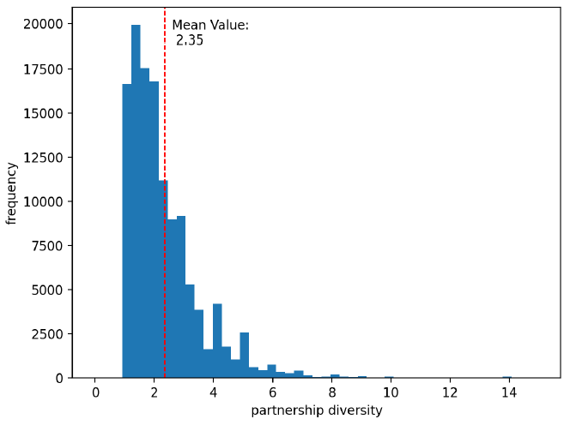
Preliminary Findings
PD
Contributors could generally collaborate on more than two kinds tasks
Given that there are 14 different contributor roles theoretically that two partners can work on, the diversity of the partnership remains quite mild.

Slide 11
Conclusion
Limited existence of Partnership
Relatively strong partnership strength than in CAN forms
Mild partnership diversity
Next steps：
definition of partnership
Threshold/baseline design （Null Models and etc）
Effect on scientific performance

Slide 12
Q&A
You questions and comments
are valued and MOST welcomed!

